Slide 1
CONCEPT LEARNING

Slide 2
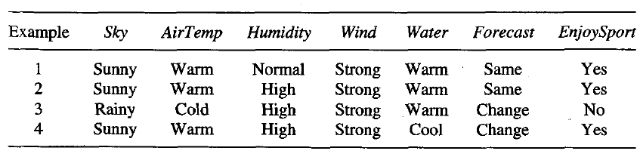
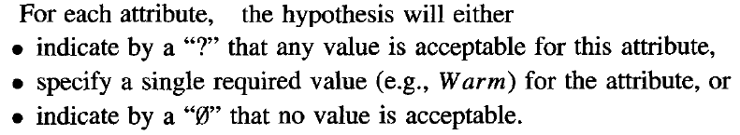
A CONCEPT LEARNING TASK
In general, any concept learning task can be described by the set of instances over which the target function is defined, the target function, the set of candidate hypotheses considered by the learner, and the set of available training examples.
Consider the example task of learning the target concept "days on which my friend Rahul enjoys his favourite water sport.“

Slide 3
Notations
To illustrate, the hypothesis that Rahul enjoys his favorite sport only on cold days with high humidity (independent of the values of the other attributes) is represented by the expression
<?, Cold, High, ?, ?, ?>
The most general hypothesis-that every day is a positive example-is represented by
<?, ?, ?, ?, ?, ?>
and the most specific possible hypothesis-that no day is a positive example-is represented by
<Ф, Ф, Ф, Ф, Ф, Ф>
The set of items over which the concept is defined is called the set of instances, which we denote by X.
The concept or function to be learned is called the target concept, which we denote by c. In general, c can be any boolean valued function defined over the instances X; that is, c : X→{O, 1}.
In the current example, the target concept corresponds to the value of the attribute EnjoySport (i.e., c(x) = 1 if EnjoySport = Yes, and c(x) = 0 if EnjoySport = No).

Slide 4
When learning the target concept, the learner is presented a set of training examples, each consisting of an instance x from X, along with its target concept value c(x) Instances for
  which c(x) = 1 are called positive examples, or members of the target concept.
  Instances for which C(X) = 0 are called negative examples, or nonmembers of the target concept.
We will often write the ordered pair (x, c(x)) to describe the training example consisting of the instance x and its target concept value c(x). We use the symbol D to denote the set of available training examples.
We use the symbol H to denote the set of all possible hypotheses that the learner may consider regarding the identity of the target concept.
The goal of the learner is to find a hypothesis h such that h(x) = c(x) for all x in X.

Slide 5
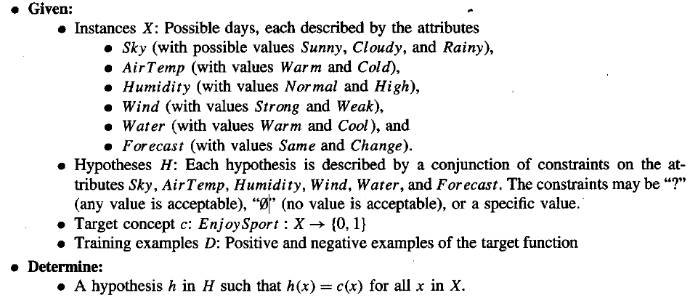
The EnjoySport concept learning task.

Slide 6
The Inductive Learning Hypothesis
Notice that although the learning task is to determine a hypothesis h identical to the target concept c over the entire set of instances X, the only information available about c is its value over the training examples.
The inductive learning hypothesis: Any hypothesis found to approximate the target function well over a sufficiently large set of training examples will also approximate the target function well over other unobserved examples.

Slide 7
CONCEPT LEARNING AS SEARCH
Concept learning can be viewed as the task of searching through a large space of hypotheses.
The goal of this search is to find the hypothesis that best fits the training examples.
  for example, the instances X and hypotheses H in the EnjoySport learning task.
    Given that the attribute Sky has three possible values, and that AirTemp, Humidity, Wind, Water, and Forecast each have two possible values.
    The instance space X contains exactly 3.2.2.2.2.2 = 96 distinct instances.
    A similar calculation shows that there are 5.4.4.4.4.4=5120 syntactically distinct hypotheses within H.
We will be particularly interested in algorithms capable of efficiently searching very large or infinite hypothesis spaces, to find the hypotheses that best fit the training data.

Slide 8
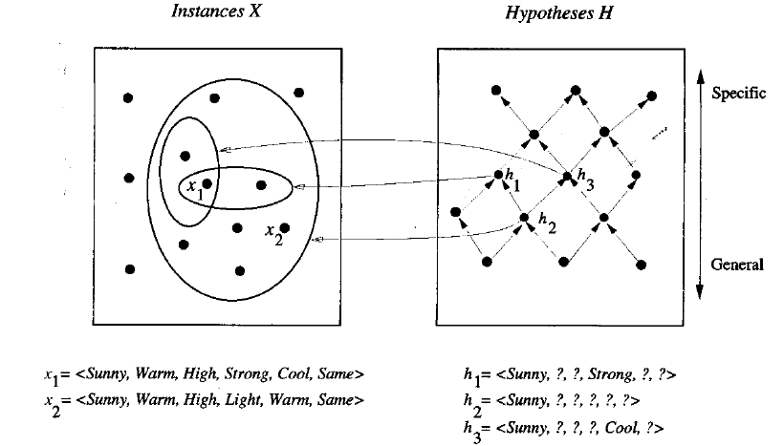
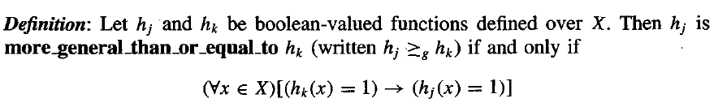
General-to-Specific Ordering of Hypotheses
we can design learning algorithms that exhaustively search even infinite hypothesis spaces without explicitly enumerating every hypothesis. To illustrate the general-to-specific ordering,
  consider the two hypotheses
    h1 = (Sunny, ?, ?, Strong, ?, ?)
    h2 = (Sunny, ?, ?, ?, ?, ?)
    Now consider the sets of instances that are classified positive by h1 and by h2.
  In fact, any instance classified positive by h1 will also be classified positive by h2. Therefore, we say that h2 is more general than h1.
For any instance x in X and hypothesis h in H, we say that x satisies h if and only if h(x) = 1.

